Slide 1
BioNetGen Overview
Jim Faeder
2022 Cell Modeling Workshop
July 11, 2022

Slide 2
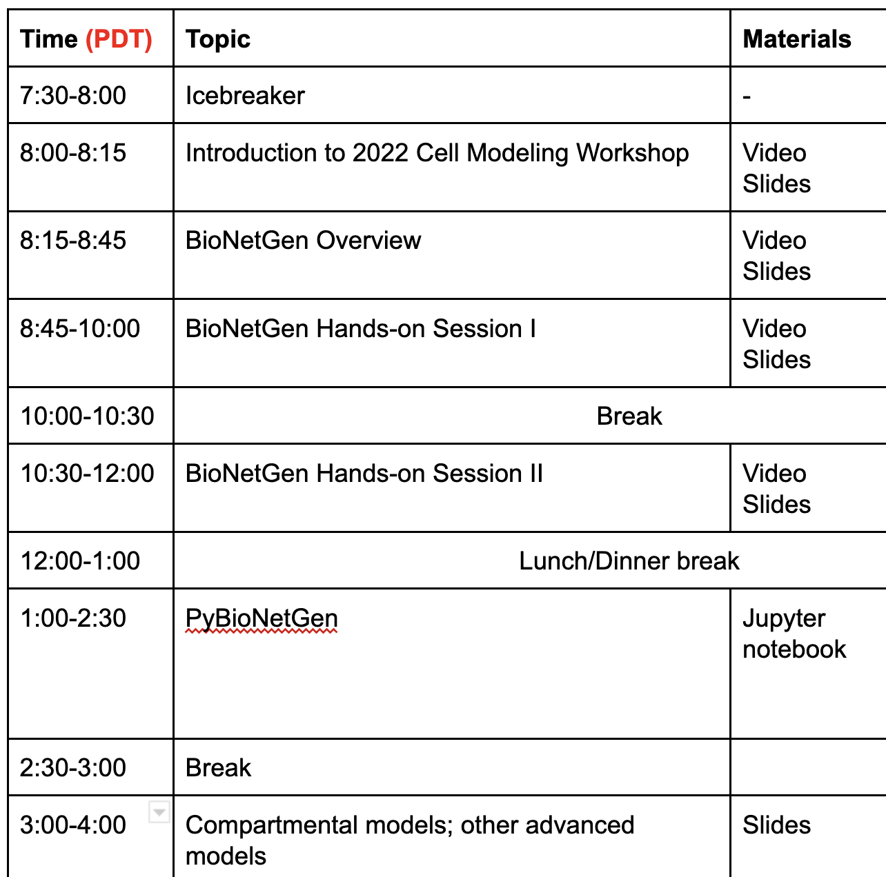
Outline of Day 1

Slide 3
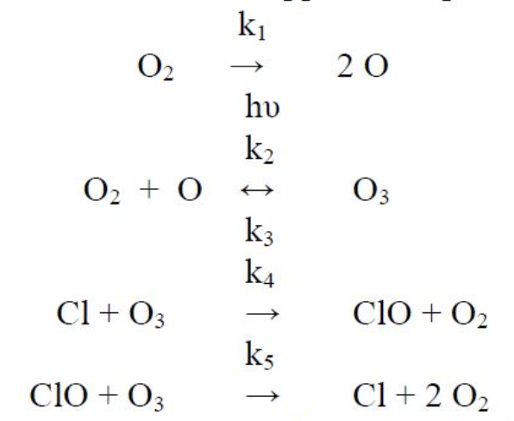
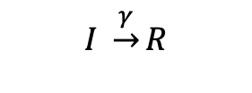
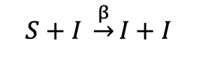
Reaction Networks Models can be used to describe a wide range of natural processes.
Chemistry
Epidemiology
Molecular biology
Ozone formation in the upper atmosphere
Susceptible-Infected-Recovered (SIR)
Signaling network
$$S+I \underset{→}{β}I+I$$
$$I \underset{→}{γ}R$$
Notes:
Credits:
Ozone formation reactions: https://www.chegg.com/homework-help/questions-and-answers/q-1-ozone-formation-upper-atmosphere-involves-following-reactions-ki-2-o-hu-k2-o2-o-k3-k4--q39635461
SIR model:
Signaling network: https://www.ebi.ac.uk/biomodels-main/static-pages.do?page=ModelMonth%2F2006-08

Slide 4
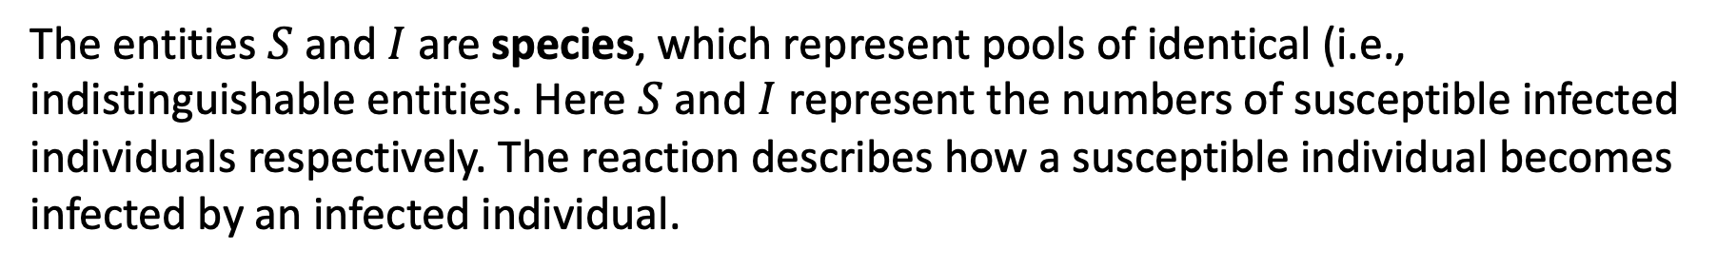
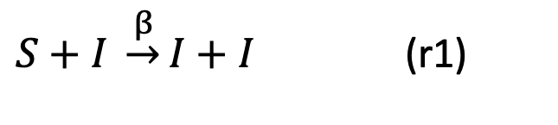
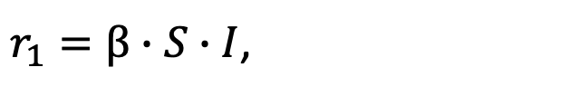
Reaction kinetics are defined by a few simple concepts.
Consider the reaction
$S+I \underset{→}{β}I+I$ (r1)
The entities $S$ and $I$ are species, which represent pools of identical (i.e., indistinguishable entities. Here $S$ and $I$ represent the numbers of susceptible infected individuals respectively. The reaction describes how a susceptible individual becomes infected by an infected individual.
The parameter $β$ is a rate constant, and the rate at which the reaction occurs is given by
$r_{1}=β∙S∙I$,
according the the simplest description given by mass action kinetics, which says that the rate of a reaction is given as the product of the reactant concentrations times the rate constant.

Slide 5
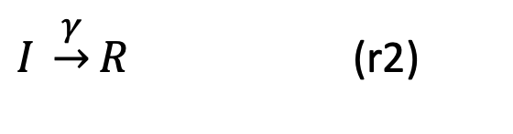
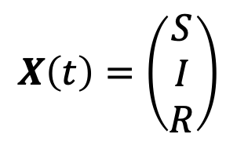
Reaction network models (RNM) are built from individual reactions.
The basic SIR model contains two reactions
$S+I \underset{→}{β}I+I$ (r1)
$I \underset{→}{γ}R$ (r2)
and three species: $S$, $I$, and $R$, which represents the number of recovered individuals.
An RNM tracks the values of the species concentrations as a function of time, which can be written as the vector
$$X\left(t\right)=\left(\begin{matrix}S \\ I \\ R\end{matrix}\right)$$
A complete RNM consists of a set of reactions, species, rate constants, and the initial values (also called initial concentrations) of the species, denoted $X\left(0\right).$

Slide 6
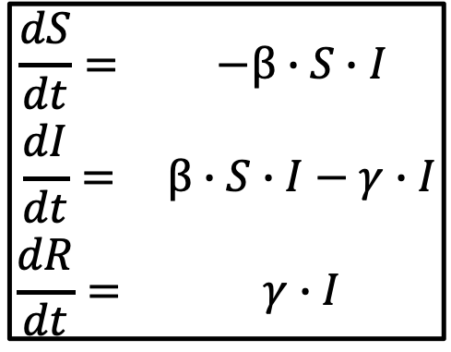
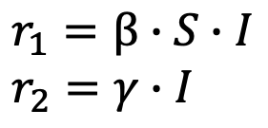
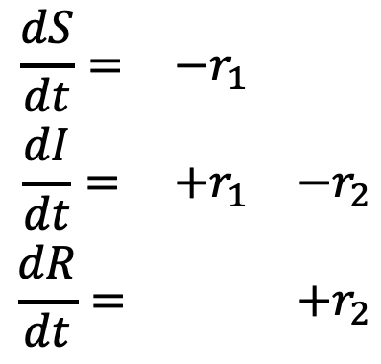
Ordinary differential equations (ODEs) describe the mean behavior of a reaction network.
The SIR model contains two reactions
$S+I \underset{→}{β}I+I$ (r1)
$I \underset{→}{γ}R$ (r2)
which give rise to three ODE’s
r1
r2
$$\begin{matrix}\frac{dS}{dt}= & −r_{1} & \\ \frac{dI}{dt}= & +r_{1} & −r_{2} \\ \frac{dR}{dt}= & & +r_{2}\end{matrix}$$
$$\begin{matrix}\frac{dS}{dt}= & −β∙S∙I \\ \frac{dI}{dt}= & β∙S∙I−γ∙I \\ \frac{dR}{dt}= & γ∙I\end{matrix}$$
where the rates are given by
$$r_{1}=β∙S∙I \\ r_{2}=γ∙I$$

Slide 7
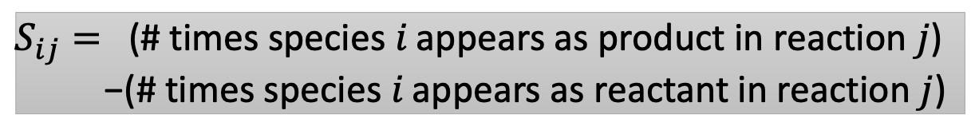
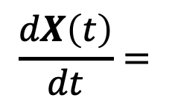
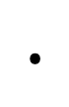
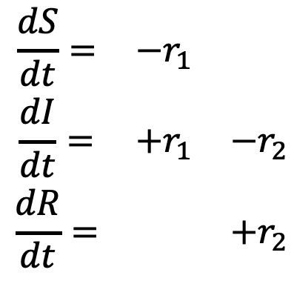
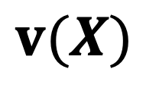
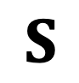
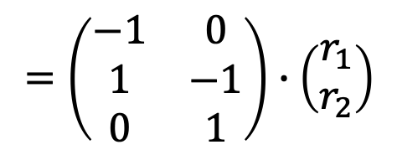
The ODEs for RNMs have a compact representation using the stoichiometry matrix.
r1
r2
$$\begin{matrix}\frac{dS}{dt}= & −r_{1} & \\ \frac{dI}{dt}= & +r_{1} & −r_{2} \\ \frac{dR}{dt}= & & +r_{2}\end{matrix}$$
$$\frac{dX\left(t\right)}{dt}=$$
$$=\left(\begin{matrix}−1 & 0 \\ 1 & −1 \\ 0 & 1\end{matrix}\right)∙\left(\begin{matrix}r_{1} \\ r_{2}\end{matrix}\right)$$
$$S$$
$$∙$$
$$v(X)$$
Stoichiometry matrix
Reaction fluxes
The elements of S are given by
$S_{ij}=$ (# times species 𝑖 appears as product in reaction $j$)
−(# times species 𝑖 appears as reactant in reaction $j$)

Slide 8
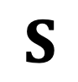
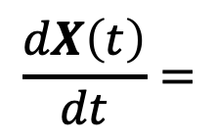
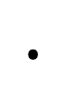
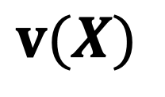
ODEs for most RNMs are solved numerically.
The general equation for RNM dynamics is
$$\frac{dX\left(t\right)}{dt}=$$
$$∙$$
$$S$$
$$v(X)$$
These equations are in general nonlinear.
They cannot be solved analytically except in special cases.
Numerical integration is required to obtain a solution.
“Stiffness” arises because reactions occur on different timescales, requiring special techniques to obtain accurate solutions efficiently.
Widely used solvers are CVODE and LSODA packages.
Accessed using ode method in the simulate command of BNG.

Slide 9
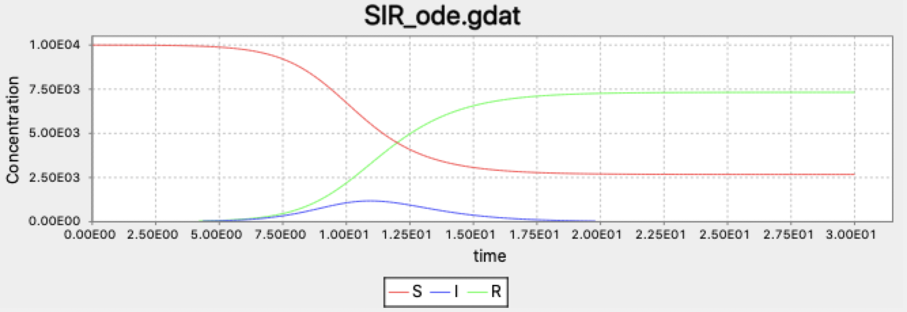

Numerical solution of SIR model describes dynamics of infection outbreak.
Time course for S, I, and R produced by BioNetGen and displayed in RuleBender.
$$\left(\begin{matrix}β \\ γ\end{matrix}\right)=\left(\begin{matrix}1.8×{10}^{−3} \\ 1\end{matrix}\right), \left(\begin{matrix}S(0) \\ I(0) \\ R(0)\end{matrix}\right)=\left(\begin{matrix}9,999 \\ 1 \\ 0\end{matrix}\right)$$

Slide 10
ODEs ignore the discrete nature of individuals in a network and neglect the effects of noise.
ODEs treat all variables as continuous and cannot account for the discrete nature of individuals.
ODEs in general (with exceptions) describe the average behavior of a system, but noise can affect real-world dynamics, e.g., disease outbreaks.
The same reaction network description can be used to generate stochastic time courses (“trajectories”) that exactly sample the true probability distribution.

Slide 11
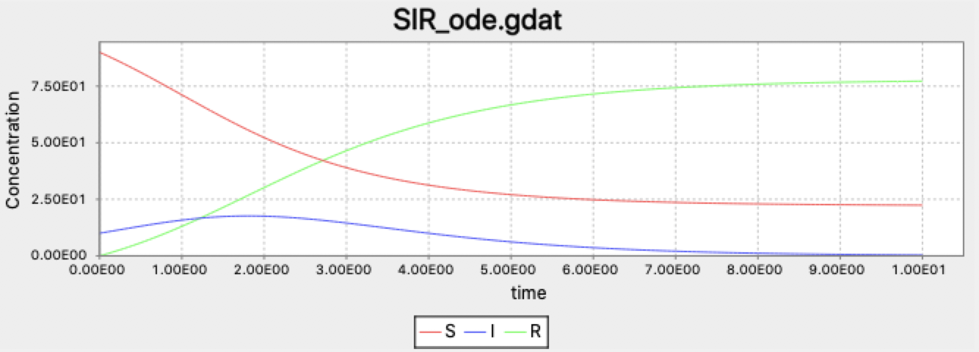
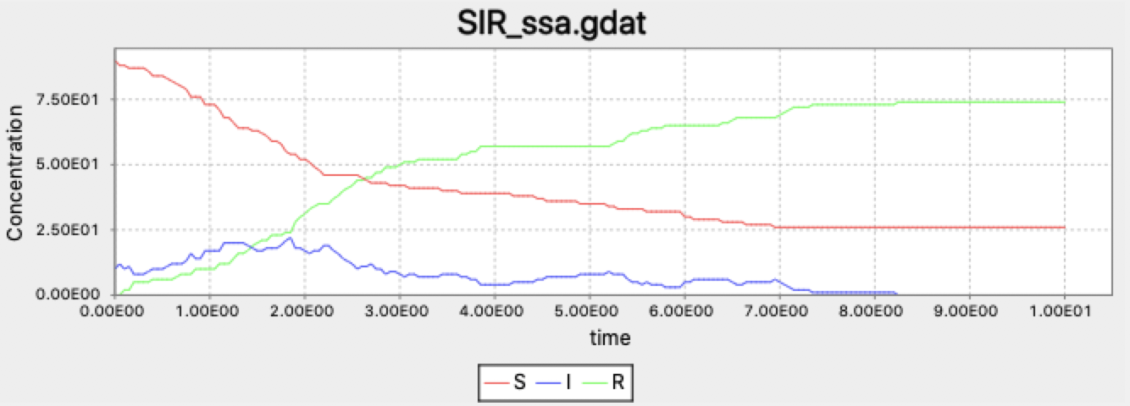

Stochastic simulations can reveal the effects of noise in finite populations.
ODE simulation
Stochastic simulation
SIR model with
$$\left(\begin{matrix}β \\ γ\end{matrix}\right)=\left(\begin{matrix}1.8×{10}^{−2} \\ 1\end{matrix}\right), \left(\begin{matrix}S(0) \\ I(0) \\ R(0)\end{matrix}\right)=\left(\begin{matrix}90 \\ 10 \\ 0\end{matrix}\right)$$

Slide 12
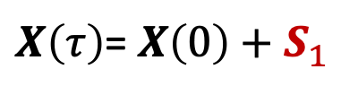
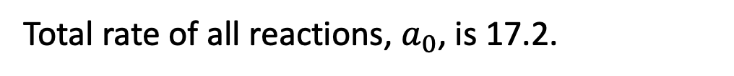
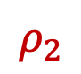
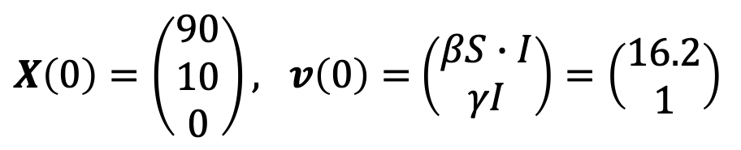
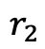
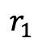
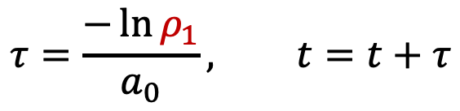
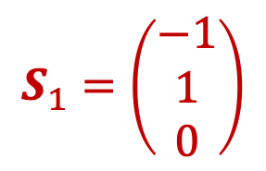
Stochastic dynamics can be computed with the Gillespie Algorithm.
BioNetGen’s ssa method
Gillespie’s Direct Method illustrated for the SIR model. At time t=0 we have
$X\left(0\right)=\left(\begin{matrix}90 \\ 10 \\ 0\end{matrix}\right), v\left(0\right)=$ $\left(\begin{matrix}βS∙I \\ γI\end{matrix}\right)=\left(\begin{matrix}16.2 \\ 1\end{matrix}\right)$
Total rate of all reactions, $a_{0}$, is 17.2.
$$τ=\frac{−\ln{ρ_{1}}}{a_{0}}, t=t+τ$$
Time of next reaction is chosen as
Index of next reaction, j, is chosen using so probability of each reaction firing is proportional to its rate.
$$r_{1}$$
$$r_{2}$$
$$S_{1}=\left(\begin{matrix}−1 \\ 1 \\ 0\end{matrix}\right)$$
$X\left(τ\right)$= $X\left(0\right)+S_{1}$
$$ρ_{2}$$

Slide 13
BioNetGen enables the construction, simulation and analysis of RNMs.
bionetgen
Command line interface
>bionetgen run –i model.bngl

Slide 14
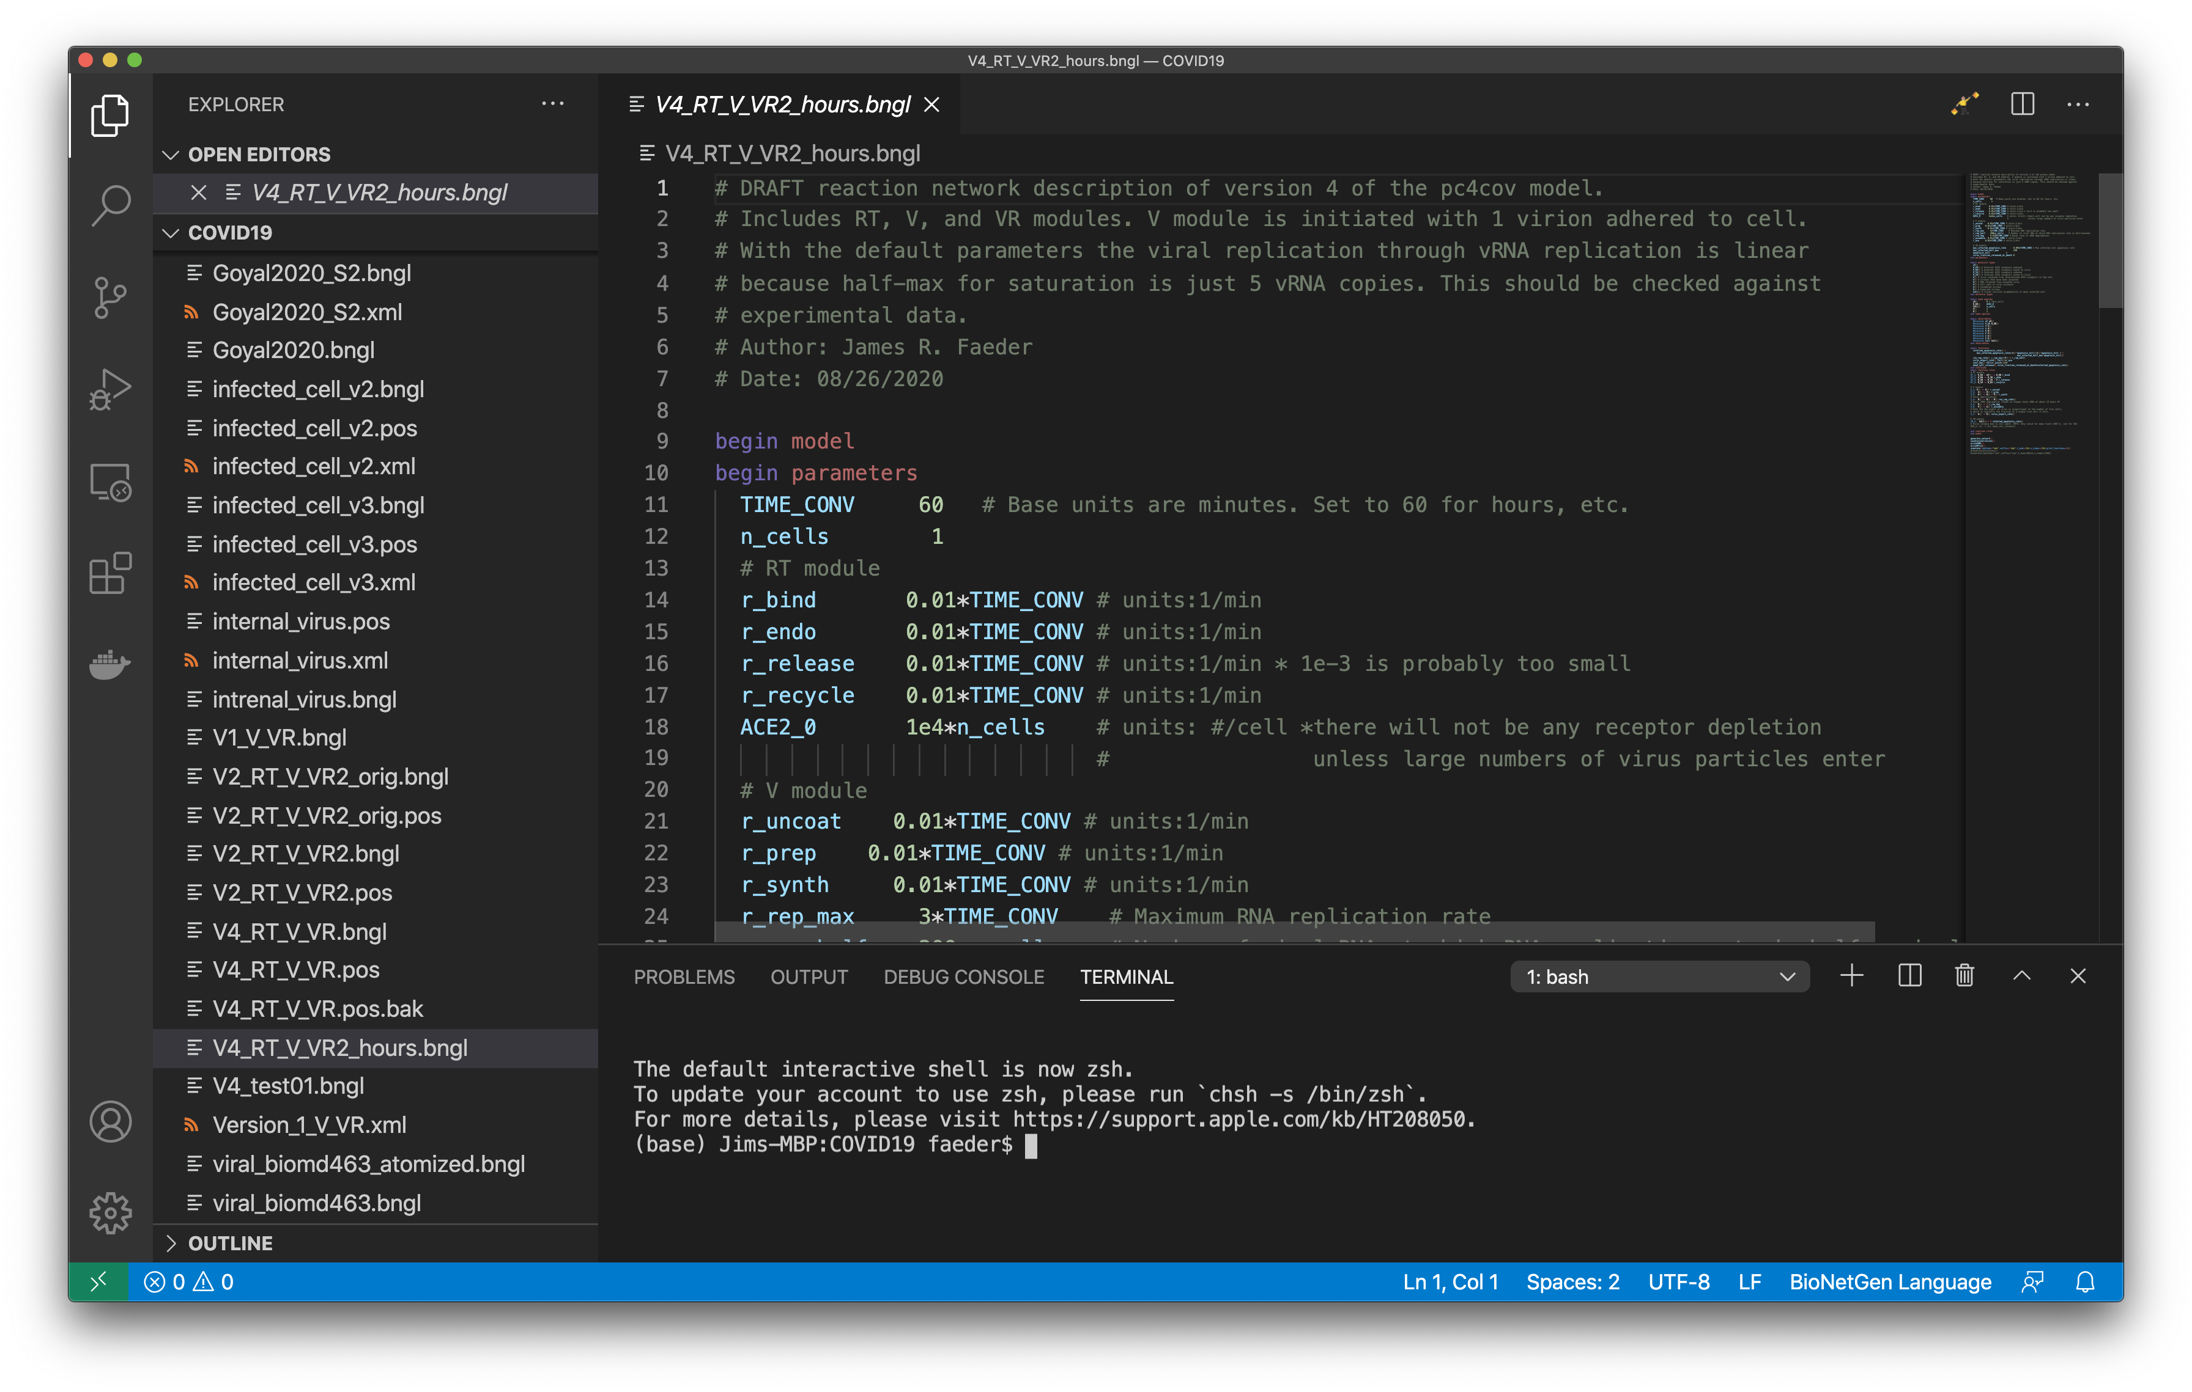
Visual Studio Code (VS Code) extension provides interactive environment for BioNetGen
Action button for
model simulation
Ali Sinan Saglam

Slide 15
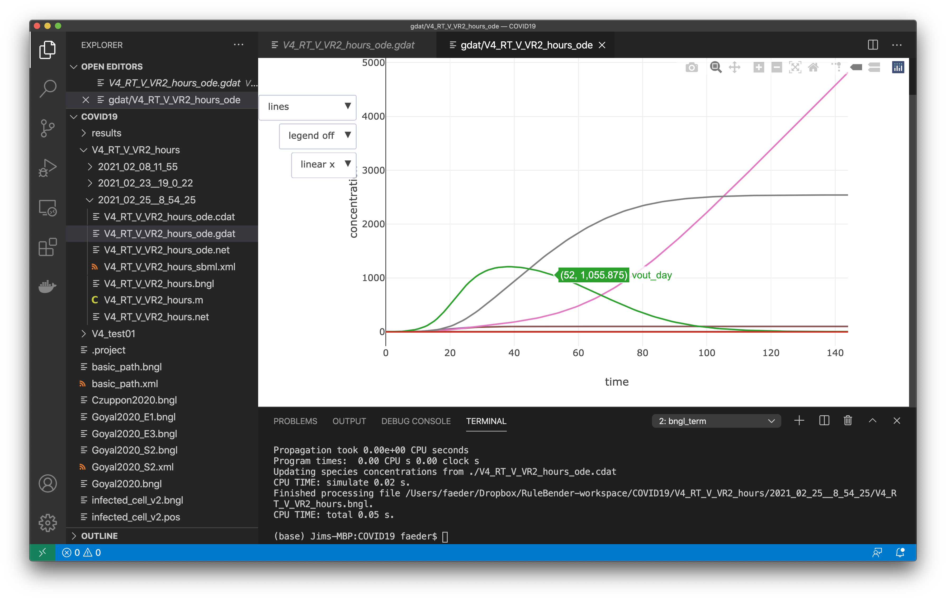
Visual Studio Code (VS Code) extension provides interactive environment for BioNetGen
Interactive plotting
Ali Sinan Saglam

Slide 16
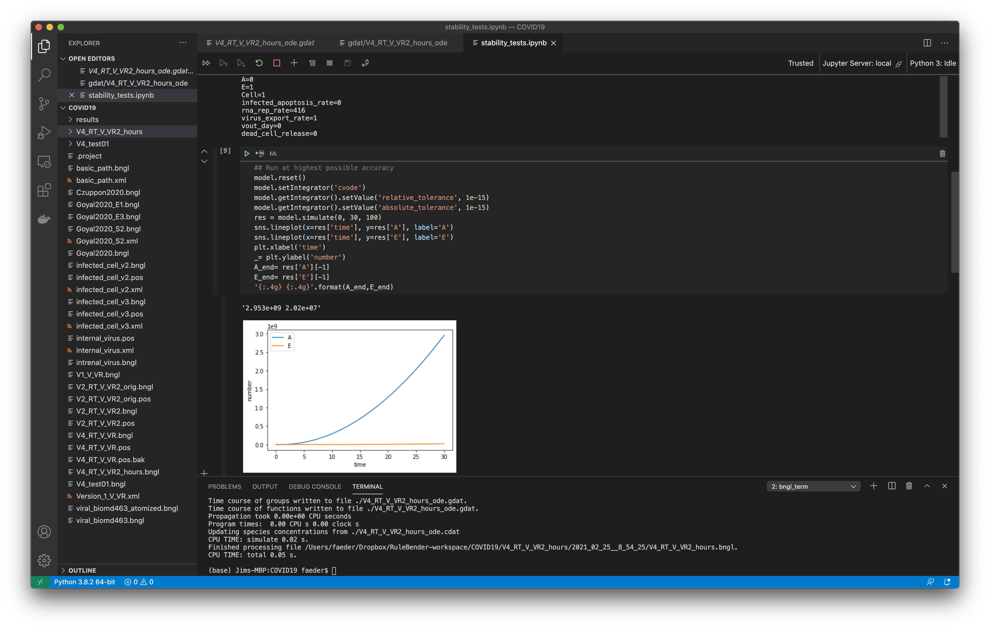
Visual Studio Code (VS Code) extension provides interactive environment for BioNetGen
Deeper model analysis using Jupyter notebooks
Ali Sinan Saglam

Slide 17
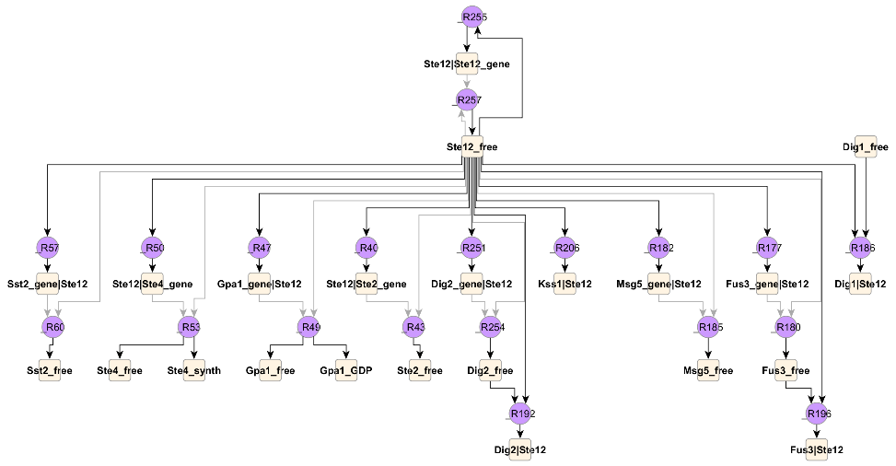

Overview of Rule-based modeling of cell signaling
JIM Faeder
Department of Computational and Systems Biology
University of Pittsburgh School of Medicine
MMBioS Cell Modeling Workshop
July 12, 2021

Slide 18
Toward an integrated model of the cell
How to accomplish the task of linking together signaling modules that determine cell fate?
^{Tyson and Novak,} ^{Annu. Rev. Phys. Chem. 61,} ^{219–40 (2010)}

Slide 19
Integrated Model of MCF10A Cell
Coded in Matlab
Bouhaddou et al. (2017) PLOS Computational Biology

Slide 20
Specification
Translating knowledge about intracellular biochemistry into executable models

Slide 21
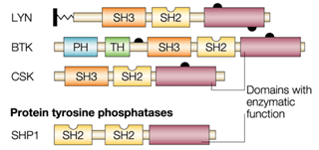
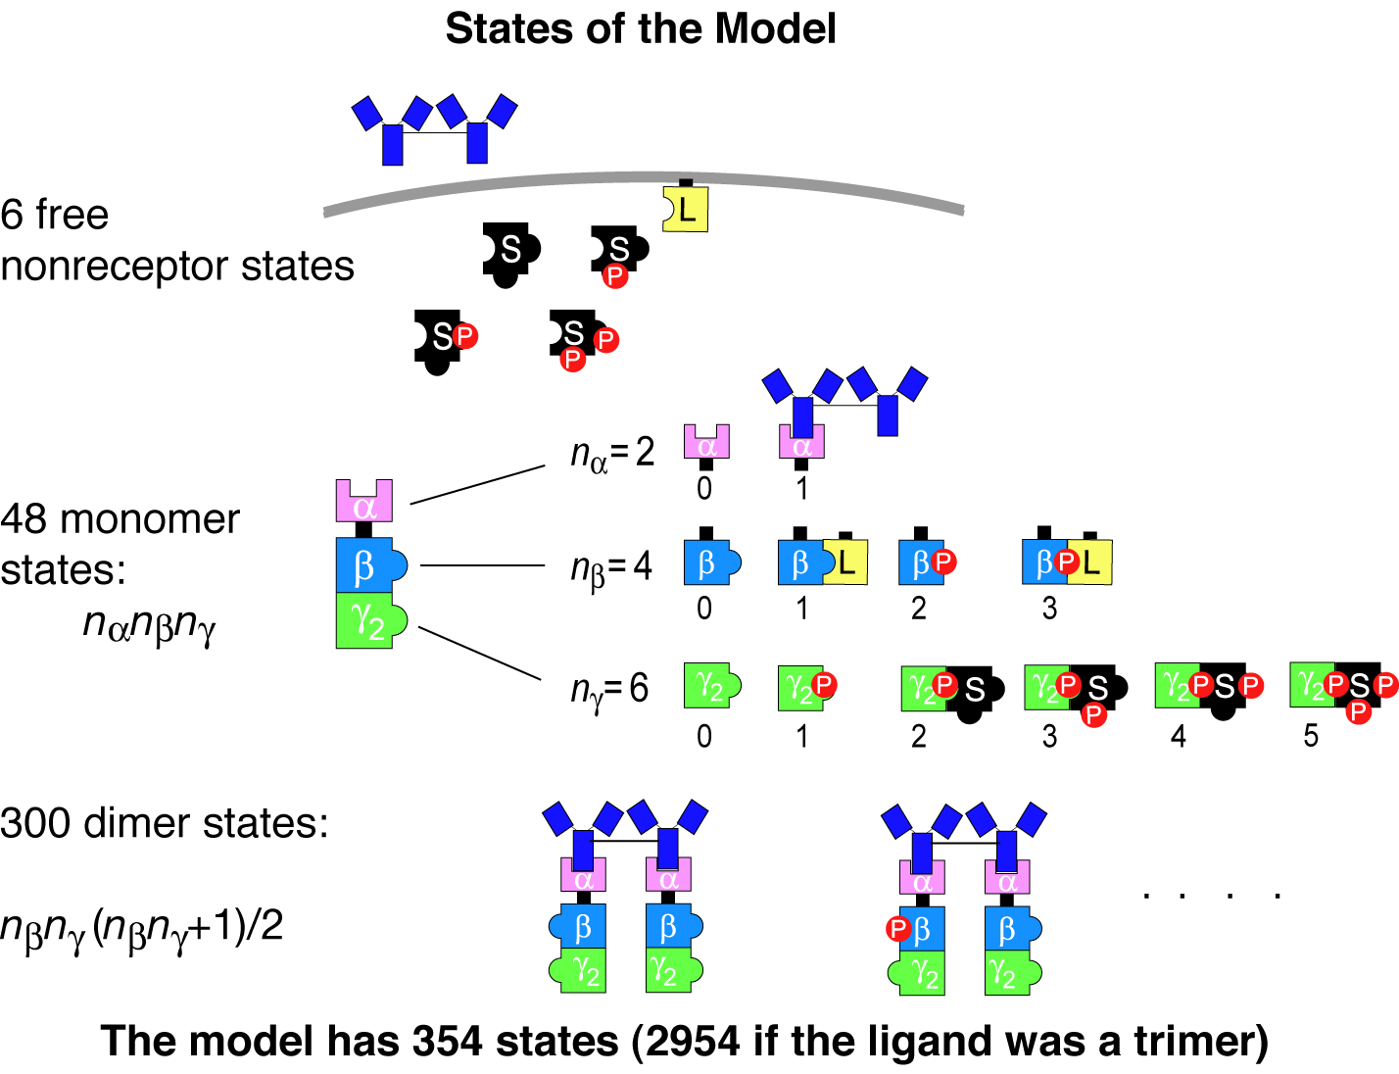
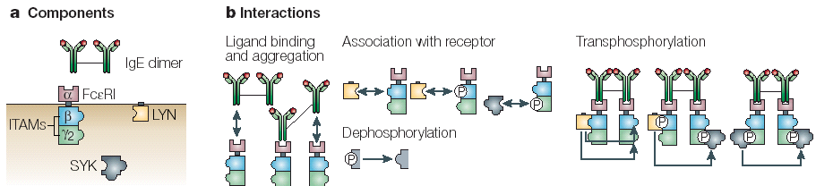
Challenges of modeling cell regulatory networks
Proteins are multi-functional
Representing their known interactions requires handling of combinatorial complexity
multiple sites of binding
multiple sites of posttranslational modification
Small number of rules
Small number of components and interactions ➔huge number of possible species and reactions

Slide 22
Combinatorial complexity in a realistic model of EGFR signaling
ErbB3:ErbB1 has > 3.8x10⁹ states
ErbB1:ErbB1 has > 5.5x10¹⁰ states
Such models can be built from a manageable number of rules – 10’s to 100’s
Creamer et al. (2012) BMC Syst. Biol.

Slide 23
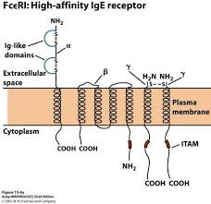
What is Rule-based Modeling (RBM)?
Molecules are modeled as structured objects
LYN(SH3,SH2,kin,Y397~0~P,Y508~0~P)
Molecule
States
Components
FceRI(a_Ig,b_Y218~0~P,g_ITAM~0~P)

Slide 24
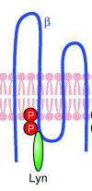
What is Rule-based Modeling (RBM)?
Rules define the interactions of molecules
“Lyn SH2 domain binds to phosphorylated Tyr 218 on the β subunit of FcεRI ”
Reactants
Products
Rate Law
Rule:
LYN(SH2) + FceRI(bY_218~P) <-> LYN(SH2!1).FceRI(bY_218~P!1) kpL, kmL
bond
“Don’t write don’t care” – elements not mentioned may be in any state
➔ One rule can generate reactions involving many different species
Reaction rate determined by Mass Action kinetics
rate forward = kpL*[Lyn(SH2)]*[FceRI(bY_218~P)]

Slide 25
Composition of a Rule-Based Model
Molecules (4)
Reaction Rules (19)
BioNetGen language
begin molecule types
Lig(l,l)
Lyn(U,SH2)
Syk(tSH2,l~U~P,a~U~P)
Rec(a,b~U~P,g~U~P)
end molecule types
begin reaction_rules
# Ligand-receptor binding
1 Rec(a) + Lig(l,l) <-> Rec(a!1).Lig(l!1,l) kp1, km1
Rec(a) + Lig(l,l) <-> Rec(a!1).Lig(l!1,l) kp1, km1
# Receptor-aggregation
2 Rec(a) + Lig(l,l!1) <-> Rec(a!2).Lig(l!2,l!1) kp2,km2
# Constitutive Lyn-receptor binding
3 Rec(b~Y) + Lyn(U,SH2) <-> Rec(b~Y!1).Lyn(U!1,SH2) kpL, kmL
…

Slide 26
Composition of a Rule-Based Model
Molecule types (4)
Reaction Rules (19)
Network Generation
Species (354)
Reactions(3680)
1 Lig(l,l) Lig_tot
2 Lyn(SH2,U) Lyn_tot
3 Syk(a~Y,l~Y,tSH2) Syk_tot
4 Rec(a,b~Y,g~Y) Rec_tot
5 Lig(l!1,l).Rec(a!1,b~Y,g~Y) 0
6 Lyn(SH2,U!1).Rec(a,b~Y!1,g~Y) 0
7 Lig(l!1,l).Lyn(SH2,U!2).Rec(a!1,b~Y!2,g~Y) 0
8 Lig(l!1,l!2).Rec(a!2,b~Y,g~Y).Rec(a!1,b~Y,g~Y) 0
9 Lig(l!1,l!2).Lyn(SH2,U!3).Rec(a!2,b~Y!3,g~Y).Rec(a!1,b~Y,g~Y) 0
…
1 Rec(a,b~Y,g~Y) + Lig(l,l) -> Lig(l!1,l).Rec(a!1,b~Y,g~Y) 2*kp1
2 Rec(a,b~Y,g~Y) + Lyn(SH2,U) -> Lyn(SH2,U!1).Rec(a,b~Y!1,g~Y) kpL
3 Lyn(SH2,U!1).Rec(a,b~Y!1,g~Y) + Lig(l,l) -> Lig(l!1,l).Lyn(SH2,U!2).Rec(a!1,b~Y!2,g~Y) 2*kp1
4 Lig(l!1,l).Rec(a!1,b~Y,g~Y) -> Rec(a,b~Y,g~Y) + Lig(l,l) km1
5 Rec(a,b~Y,g~Y) + Lig(l!1,l).Rec(a!1,b~Y,g~Y) -> Lig(l!1,l!2).Rec(a!2,b~Y,g~Y).Rec(a!1,b~Y,g~Y) kp2
6 Lyn(SH2,U!1).Rec(a,b~Y!1,g~Y) + Lig(l!1,l).Rec(a!1,b~Y,g~Y) -> Lig(l!1,l!2).Lyn(SH2,U!3).Rec(a!2,b~Y!3,g~Y).Rec(a!1,b~Y,g~Y) kp2 7 Lig(l!1,l).Rec(a!1,b~Y,g~Y) + Lyn(SH2,U) -> Lig(l!1,l).Lyn(SH2,U!2).Rec(a!1,b~Y!2,g~Y) kpL
8 Lyn(SH2,U!1).Rec(a,b~Y!1,g~Y) -> Rec(a,b~Y,g~Y) + Lyn(SH2,U) kmL
9 Lig(l!1,l).Lyn(SH2,U!2).Rec(a!1,b~Y!2,g~Y) -> Lyn(SH2,U!1).Rec(a,b~Y!1,g~Y) + Lig(l,l) km1
…

Slide 27
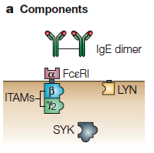
Defining Molecules
Molecules are the basic objects in a BNG model
BioNetGen Language
IgE(a,a)
FceRI(a,b~U~P,g2~U~P)
Lyn(U,SH2)
Syk(tSH2,lY~U~P,aY~U~P)
Components represent molecule elements
Domains
Motifs
Properties
Notes:
Start here – more or less.

Slide 28
Defining Molecules
Molecules are the basic objects in a BNG model
BioNetGen Language
IgE(a,a)
FceRI(a,b~U~P,g2~U~P)
Lyn(U,SH2)
Syk(tSH2,lY~U~P,aY~U~P)
Components may have different states representing
posttranslational modifications
conformational state
…
Notes:
Start here – more or less.

Slide 29
Binding
Molecules bind other molecules through components
BioNetGen Language
IgE(a,a!1).FceRI(a!1,b~U,g2~U)
Bonds are formed by linking two components. The ‘.’ indicates a set of molecules forming a complex.
Components may have both states and bonds.
Bonds may occur within a molecule.
FceRI(a,b~U!1,g2~U).Lyn(U!1)
Lyn(SH2!1,Cterm~P!1)
Notes:
Start here – more or less.

Slide 30
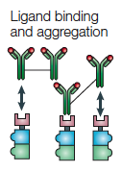
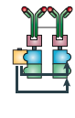
Defining Interaction Rules
BioNetGen Language
IgE(a,a)+ FceRI(a)<-> IgE(a,a!1).FceRI(a!1)
…
binding and dissociation
Transphosphorylation
Lyn(U!1).FceRI(b!1).FceRI(b~U)-> \
Lyn(U!1).FceRI(b!1).FceRI(b~P)
component state change

Slide 31
Parts of a rule
Reactants
Arrow
Products
Rate Law
IgE(a,a)+ FceRI(a)<-> IgE(a,a!1).FceRI(a!1) kp1, km1

Slide 32
Parts of a rule
Reactants
Arrow
Products
Rate Law
IgE(a,a)+ FceRI(a)<-> IgE(a,a!1).FceRI(a!1) kp1, km1
IgE(a,a)
FceRI(a,b~U,g~U)
Patterns select properties of each reactant molecule.

Slide 33
Parts of a rule
Reactants
Arrow
Products
Rate Law
IgE(a,a)+ FceRI(a)<-> IgE(a,a!1).FceRI(a!1) kp1, km1
IgE(a,a)
FceRI(a,b~U,g~U)
States of components not specified don’t affect the match.
“Don’t write, don’t care.”
FceRI(a,b~P,g~U)
Patterns select properties of each reactant molecule.

Slide 34
Parts of a rule
Reactants
Arrow
Products
Rate Law
IgE(a,a)+ FceRI(a)<-> IgE(a,a!1).FceRI(a!1) kp1, km1
IgE(a,a)+ FceRI(a,b~U,g~U)<-> IgE(a,a!1).FceRI(a!1,b~U,g~U) kp1, km1
IgE(a,a)+ FceRI(a,b~P,g~U)<-> IgE(a,a!1).FceRI(a!1,b~P,g~U) kp1, km1
Patterns select properties of each reactant molecule.
Because patterns can match many different species, each rule can generate many reactions.

Slide 35
Center and context
The center of a rule is the part that the rule changes.
bond is formed
IgE(a,a)+ FceRI(a)<-> IgE(a,a!1).FceRI(a!1) kp1, km1
The context is the part that is necessary for the rule to happen but is unchanged.

Slide 36
Center and context
The center of a rule is the part that the rule changes.
bond is formed
IgE(a,a)+ FceRI(a)<-> IgE(a,a!1).FceRI(a!1) kp1, km1
The context is the part that is necessary for the rule to happen but is unchanged.
Transphosphorylation
Context can represent complex biochemistry.
component state is changed
Lyn(U!1).FceRI(b!1).FceRI(b~U)-> \
Lyn(U!1).FceRI(b!1).FceRI(b~P)

Slide 37
Rule-based modeling enables knowledge representation on a large scale
FcεRI model
Precise encoding of modeled structures and interactions
User avoids combinatorial complexity
Amenable to visualization
Extensible as knowledge base grows
Faeder et al., J. Immunol. (2003)
Chylek et al., Mol. BioSys. (2011)

Slide 38
Rule-based modeling enables knowledge representation on a large scale
FcεRI model
T cell receptor model
20 molecule types
129 rules
Number of species is too large for network generation!
Faeder et al., J. Immunol. (2003)
Chylek et al., PLOS One (2014)

Slide 39
Simulation
Scalable simulation of rule-based models

Slide 40
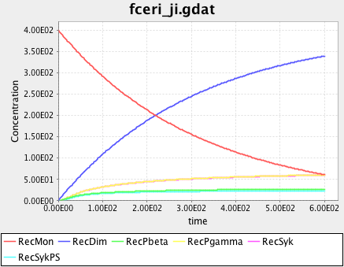
Methods for simulating RBMs
Model Specification
Indirect
Network Generation
1 Rec(a,b~Y,g~Y) + Lig(l,l) -> Lig(l!1,l).Rec(a!1,b~Y,g~Y) 2*kp1
2 Rec(a,b~Y,g~Y) + Lyn(SH2,U) -> Lyn(SH2,U!1).Rec(a,b~Y!1,g~Y) kpL
3 Lyn(SH2,U!1).Rec(a,b~Y!1,g~Y) + Lig(l,l) -> Lig(l!1,l).Lyn(SH2,U!2).Rec(a!1,b~Y!2,g~Y) 2*kp1
4 Lig(l!1,l).Rec(a!1,b~Y,g~Y) -> Rec(a,b~Y,g~Y) + Lig(l,l) km1
5 Rec(a,b~Y,g~Y) + Lig(l!1,l).Rec(a!1,b~Y,g~Y) -> Lig(l!1,l!2).Rec(a!2,b~Y,g~Y).Rec(a!1,b~Y,g~Y) kp2
6 Lyn(SH2,U!1).Rec(a,b~Y!1,g~Y) + Lig(l!1,l).Rec(a!1,b~Y,g~Y) -> Lig(l!1,l!2).Lyn(SH2,U!3).Rec(a!2,b~Y!3,g~Y).Rec(a!1,b~Y,g~Y) kp2 7 Lig(l!1,l).Rec(a!1,b~Y,g~Y) + Lyn(SH2,U) -> Lig(l!1,l).Lyn(SH2,U!2).Rec(a!1,b~Y!2,g~Y) kpL
8 Lyn(SH2,U!1).Rec(a,b~Y!1,g~Y) -> Rec(a,b~Y,g~Y) + Lyn(SH2,U) kmL
9 Lig(l!1,l).Lyn(SH2,U!2).Rec(a!1,b~Y!2,g~Y) -> Lyn(SH2,U!1).Rec(a,b~Y!1,g~Y) + Lig(l,l) km1
…
Reaction Network
Reaction Network Simulator
ODE’s, SSA

Slide 41
Combinatorial Complexity
5 proteins, 20 interactions 170,000 species

Slide 42
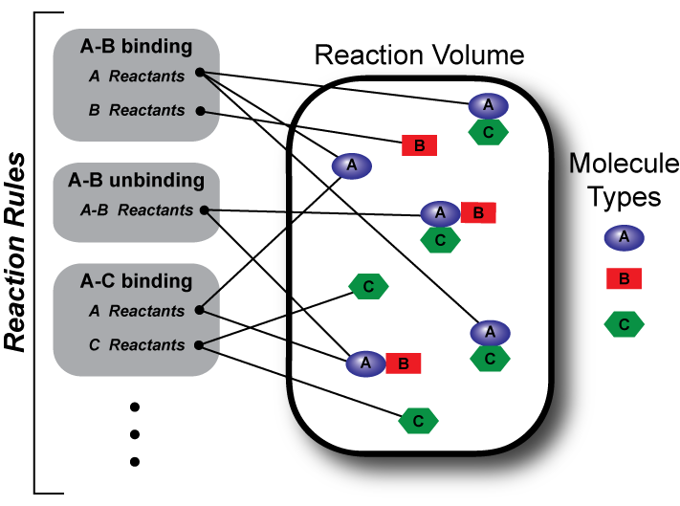
Methods for simulating RBMs
Model Specification
Indirect
Direct
Network Generation
Configuration Generation
Bypasses network generation
Reaction Network
Reaction Network Simulator
NFsim

Slide 43
Indirect Methods – Network Generation
a b c
A
B
C
contact map
reaction rules
species
a
+
A
a
A
4 molecule types
3 rules
11 species
12 reactions
b
+
B
b
B
c
+
C
c
C
reactions

Slide 44
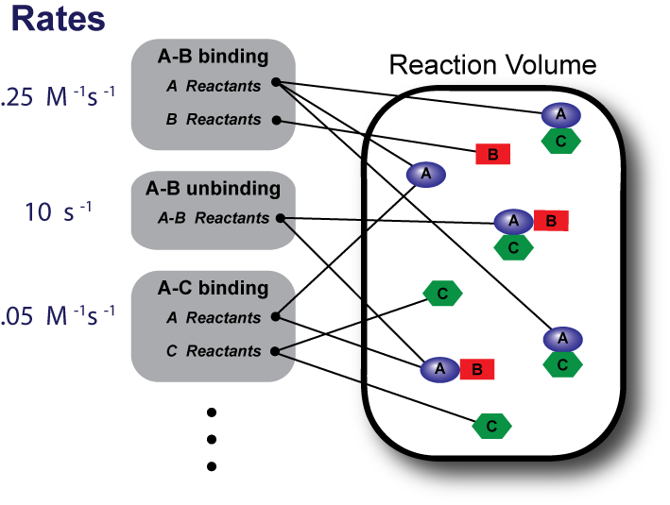
NFsim Algorithm
0. Initialize reactant lists and calculate rule propensities.
Select next reaction time and next rule.
Select molecules and sites to react.
Check any application condition(s).
Apply operation specified by rule.
Update reactant lists and propensities.
Increment time.
25 s⁻¹
10 s⁻¹
0.1 s⁻¹
Sneddon, Faeder, and Emonet (2011) Nature Methods

Slide 45
Direct Methods (NFsim)
reaction rules
event generation
a
+
A
a
a
+
A
a
A
a
A
6
4
6
a b c
A
A
B
C
a b c
B
B
C
b
+
B
b
B
a b c
a b c
B
A
C
a b c
B
6
5
B
C
6
C
B
a b c
a b c
A
A
a b c
c
+
C
c
a b c
C
C
A
B
A
a b c
A
B
C
7
3
5
a b c
C
B
a b c
A
B
A
system configuration
total propensity

Slide 46
FcεRI signaling models
NFsim can simulate models of greatly increased complexity with manageable increase in cost.
Increasing complexity
MW Sneddon, JRF, and T. Emonet (2011) Nat. Methods, 8, 177
Notes:
Would be great to have a screenshot of John’s small multiples for the FceRI models used here.

Slide 47
Other examples of network-free applications
Phosphoproteome dynamics
Multivalent aggregation in signaling
Holoenzyme dynamics
Chylek et al. (2014) PLOS One
Nag et al. (2009) Biophys. J
Kaya, Grundy et al., in progress.

Slide 48
BioNetGen and associated modeling tools
Harris, Hogg, et al. (2016) Bioinformatics, 32 (21): 3366-3368.

Slide 49
Why use RBM?
Concise and precise representation of biochemical knowledge
rules are simple (less context) when interactions are modular
Flexible with respect to simulation method
Deterministic / stochastic
Well-mixed / compartmental / spatial
Structures and rules are reusable
Rule libraries
Compact visual representation
Contact map and beyond
Contact map

Slide 50
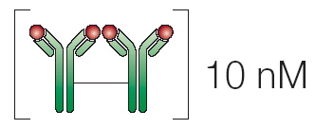



Rule-Based Modeling protocol
1. Identify components and interactions
2. Translate into objects (molecules) and rules
…
…
3. Determine concentrations and rate constants
4. Simulate and analyze the model
ODE’s
SSA
PDE’s
BD

